Slide 1
Social Data Institute
Continuing Professional Development (CPD) course
Introduction To Bayesian Inference & Modelling (June 2025)
Day 1: Introduction to Probability distribution
Dr Anwar Musah (a.musah@ucl.ac.uk)
Lecturer in Social and Geographic Data Science
UCL Geography
Additional details:
https://www.ucl.ac.uk/social-data
1

Slide 2
About the course
2
Notes:
But before we start, let’s talk about the course…

Slide 3
Social Data Institute
Description of the course
This course will introduce the foundational and advanced topics on statistical modelling within a Bayesian framework that is highly applicable for any kinds of evidence–based research for academia or industry.
This course broadly covers two areas:
How to use Bayesian Statistics for evidence-based research in making non-spatial and spatial predictions, as well as studying the associations between various risk factors and outcomes through different regression-based models.
Learning how to perform Bayesian Statistics through a software called Stan (i.e., rstan package) which interfaces with RStudio. Here, you will learn a new programming tool.
3

Slide 4
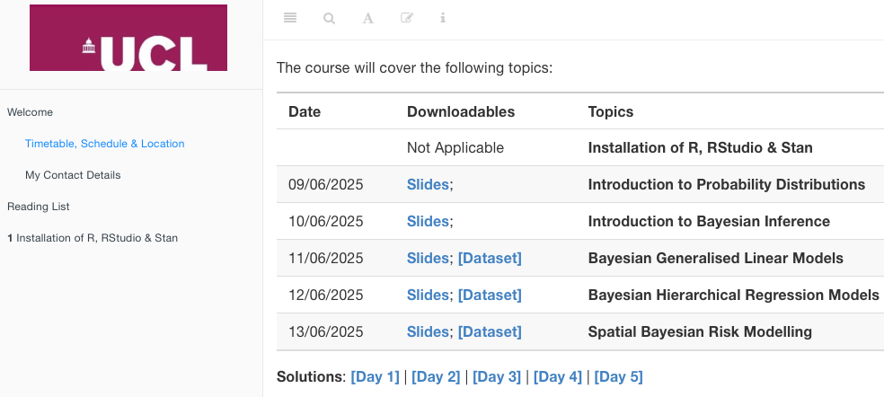
Social Data Institute
Course overview [1]
Day 1: Introduction to Probability Distributions
Day 2: Introduction to Bayesian Inference
Day 3: Bayesian Generalised Linear Models (GLMs)
Day 4: Bayesian Hierarchical Regression Models
Day 5: Spatial Bayesian Risk Modelling
All the reading list, lecture notes, dataset and information for the computer practicals, as well as their associated live recordings are hosted on a dedicated web-page for this course.
Link: https://uclpg-msc-sgds.github.io/UCL-SODA-CPD-RStan/
You can download the lecture and practical materials at
this section from the above link
4
Notes:
We will go through the following …

Slide 5
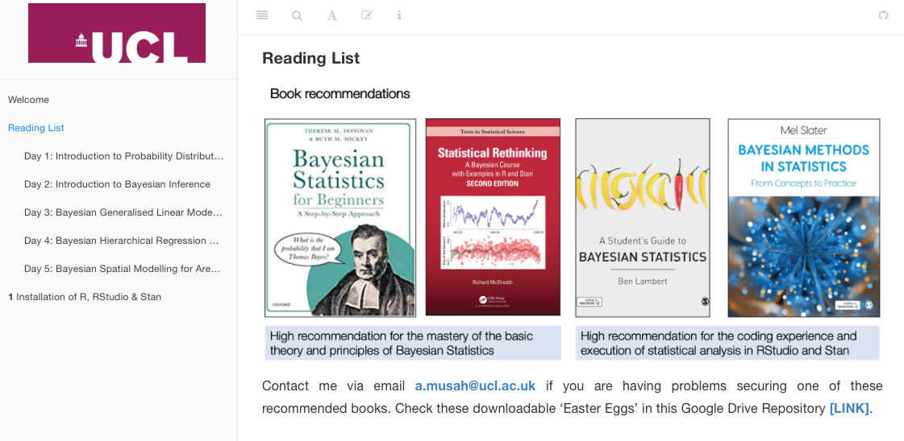
Social Data Institute
Course overview [2]
Day 1: Introduction to Probability Distributions
Day 2: Introduction to Bayesian Inference
Day 3: Bayesian Generalised Linear Models (GLMs)
Day 4: Bayesian Hierarchical Regression Models
Day 5: Spatial Bayesian Risk Modelling
All the reading list, lecture notes, dataset and information for the computer practicals, as well as their associated live recordings are hosted on a dedicated web-page for this course.
Link: https://uclpg-msc-sgds.github.io/UCL-SODA-CPD-RStan/
You can access to the recommended reading list for that day’s session
You can access the PDF books here
5

Slide 6
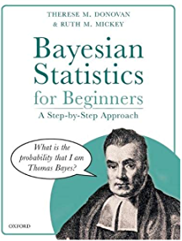
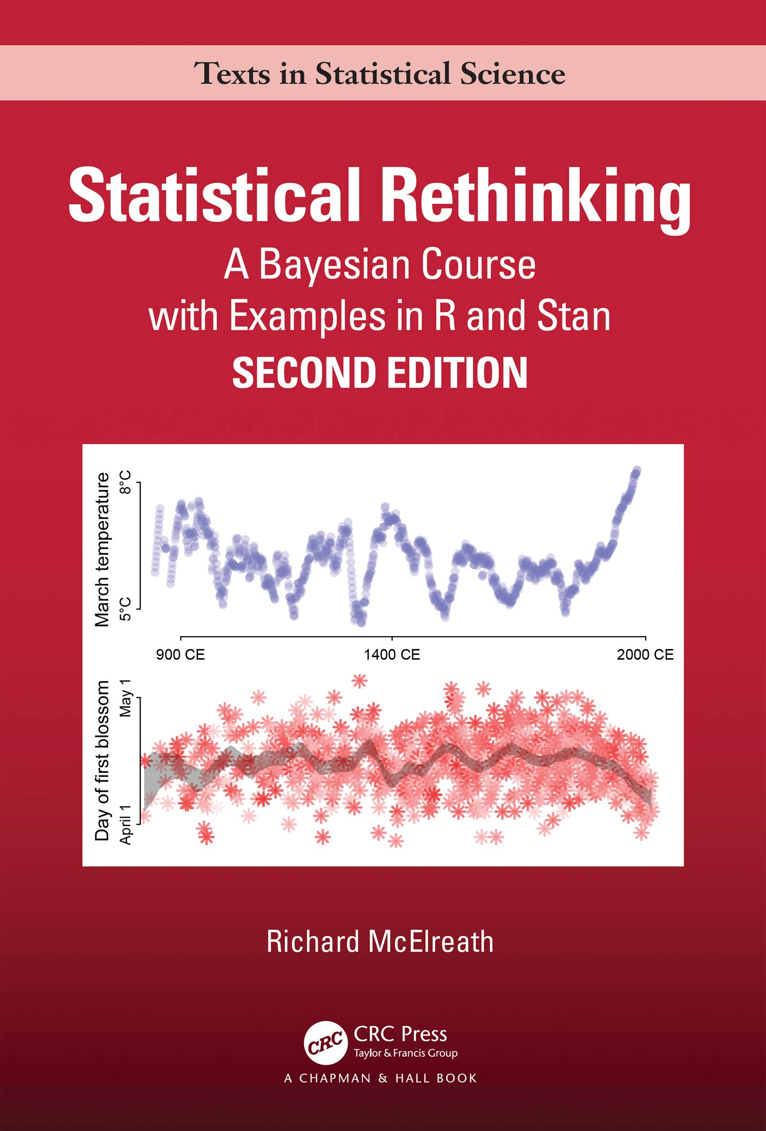
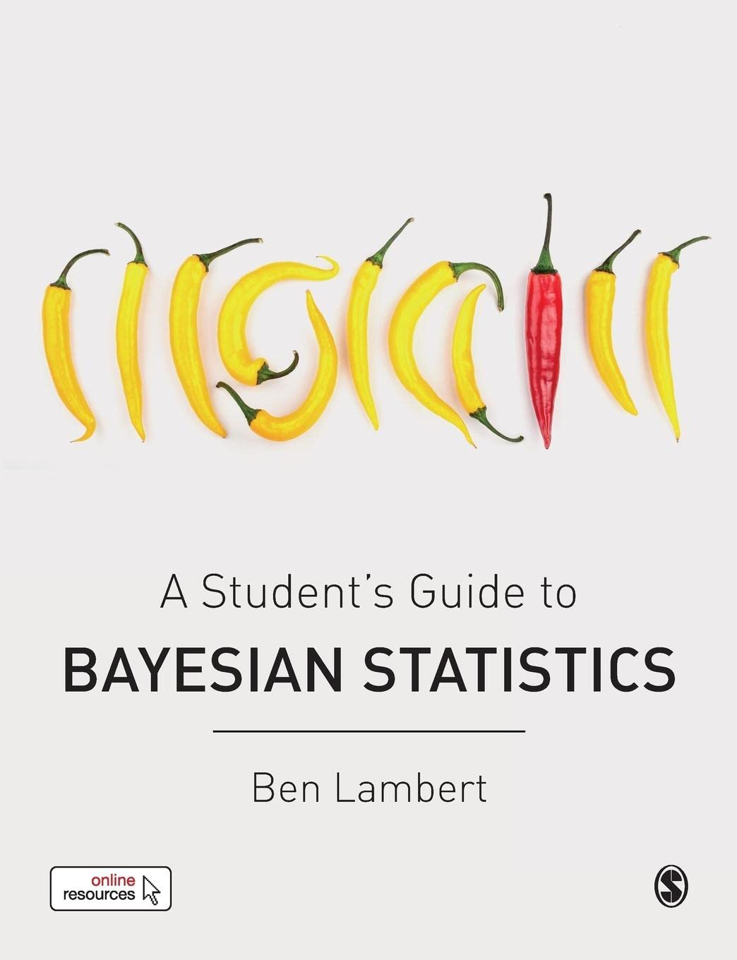
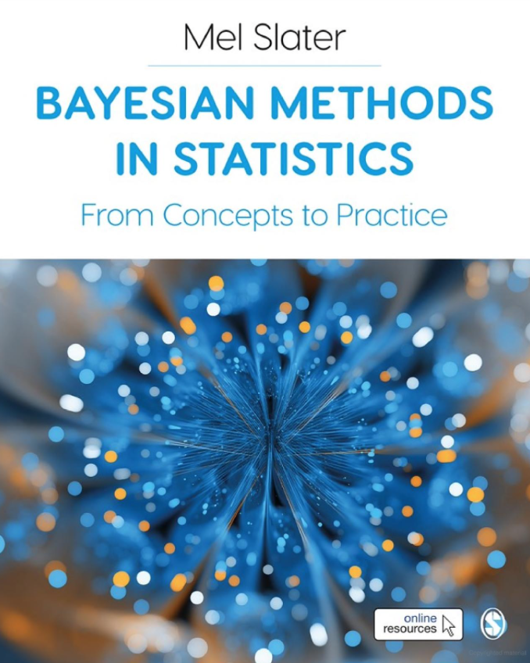
Book recommendations
High recommendation for the mastery of the basic theory and principles of Bayesian Statistics
High recommendation for the coding experience and execution of statistical analysis in RStudio and Stan
6

Slide 7
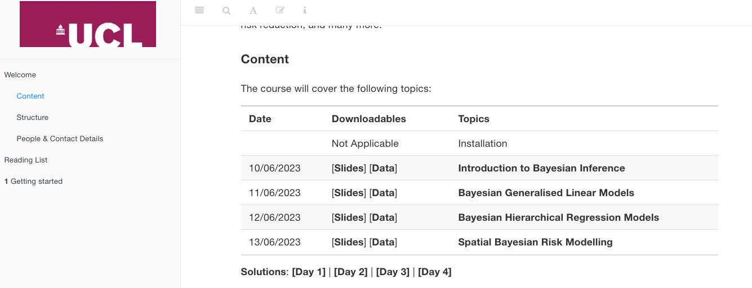
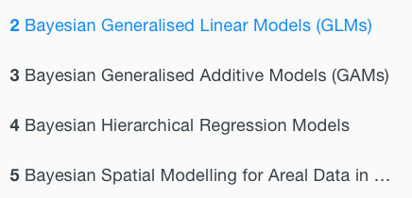
Social Data Institute
Course overview [3]
Day 1: Introduction to Probability Distributions
Day 2: Introduction to Bayesian Inference
Day 3: Bayesian Generalised Linear Models (GLMs)
Day 4: Bayesian Hierarchical Regression Models
Day 5: Spatial Bayesian Risk Modelling
All the reading list, lecture notes, dataset and information for the computer practicals, as well as their associated live recordings are hosted on a dedicated web-page for this course.
Link: https://uclpg-msc-sgds.github.io/UCL-SODA-CPD-RStan/
Access to the computer practicals for that day
The solution to the tasks for that day will be opened to you later
7

Slide 8
Social Data Institute
General format of the course
Times | Session
10:30am to 12:00pm (1.5h) | Lecture | REC
12:00pm to 01:00pm (1h) | Lunch Break
01:00pm to 02:00pm (1h) | Live Walkthrough & Demonstration | REC
02:00pm to 02:15pm (0h15mins) | Short Break
02:15pm to 04:15pm (2h) | Computer Practical Session
04:15pm to 04:30pm (0h15mins) | Wrap-up & Close
Location(s): Charles Bell House (UCL) in Room G04 [Seminar Room 4], 43-45 Forley Street, W1W 7TY (nearest underground tube stations are Goodge Street and Oxford Circus)
NOTE: All lectures and tutorials sessions will be delivered in-person. You are expected to bring you own laptop with the required software and program installed.
8

Slide 9
Social Data Institute
Contents
Problem
What is Bayesian Statistics?
Basic Probabilities – what are they & their types?
Unconditional, Joint, and Conditional Probabilities
How they work!
What are Probability distributions?
Understand the features of a distribution
The various types of distributions
How they work!
What is Bayes’ Theorem?
How the above connects with the Bayes’ rule
Stan for Bayesian Inference
Knowledge
Collect
Model
Wrangle
Explore
9

Slide 10
What is a Bayesian Statistics?
10

Slide 11


Social Data Institute
Definition:
Bayesian statistics, is all about uncertainty (i.e., lack of complete sureness or knowledge). It is essentially the practice of expressing what you believe about something as a probability (before observing that thing); and then using new evidence (after observing that thing) to update those beliefs thereafter.
Basic Probabilities
Probability Distribution
Bayes’ Theorem
Bayesian Inference
11

Slide 12
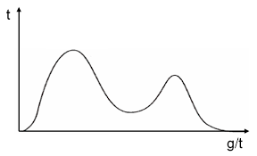
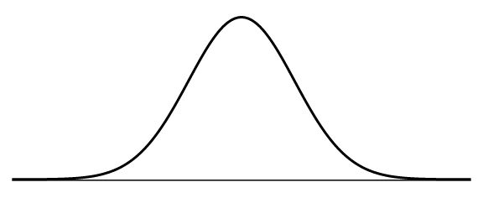
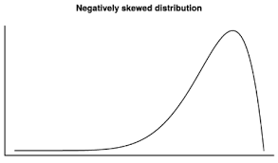
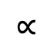

Social Data Institute
This equation is the backbone of Bayesian Statistics
User friendly formulation:
Posterior probability $∝$ Likelihood Function x Prior Probability
Mathematical formulation:
Posterior: Probability of our new parameter being true after observing the data.
Likelihood: Plausibility of the observed data we have, given the parameter has a specific value(s)
Prior: Our belief about what the parameter is, before observing the data
Notes:
This equation comprise of conditionals, and marginal probability notation. So, an understanding of what basic probabilities are helps a lot.
These marginal or conditional probabilities are expressed as distributions. In essence, you are defining, transforming and manipulating probability distributions to express and update uncertainty.
This formulation is derived from the Bayes’ Rule
$$Pr\left(Parameter | Data\right) ∝ Pr\left(Data \right| Parameter) × Pr⁡(Parameter)$$
$$∝$$
$$×$$
12

Slide 13
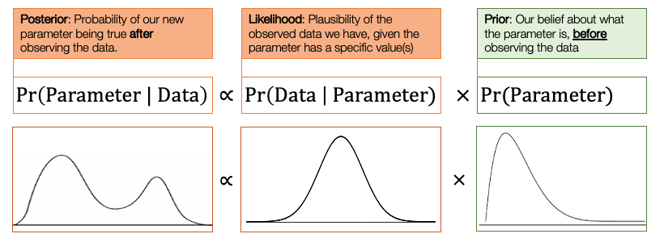


This equation is the backbone of Bayesian Statistics
Basic Probabilities
Probability Distribution
Bayes’ Rule
Bayesian Inference
13

Slide 14
Basic Probability – what is it?
14
Notes:
Here, we cover the basic terminology of probability and learn the three types of probabilities – these basic building blocks will help us to understand what Bayes’ Theorem is --- which is the key to unlocking our understanding of what Bayesian Statistics is all about.

Slide 15
Social Data Institute
Definition:
Probability is the language of uncertainty. It quantifies the uncertainty of a defined event, taking a value between 0 and 1. An event with a probability near zero implies that it is very unlikely to occur, while a probability near one implies that it is very likely.
The usual notation for a probability is: Pr( ) or P( ) or Prob( ). We will use the notation for Pr( ) throughout this lecture.
A probability, Pr( ) is always defined in relation to an event ‘E’ which has a set number of outcomes. The outcomes are calculated within a sample space (or population size), which is the total number of all possible outcomes that event ‘E’
We can write this and say Pr(E), which is read as “the probability that event E will occur”
Note 1: When we say uncertainty, we are referring to lack of complete sureness (or knowledge) about an event.
Note 2: There are three key terms here, which will be defined in the next slide – An event, an outcome, and a sample space.
15
Notes:
One can also say – a probability in it is absolute basic form is a quantity for uncertainty for a defined event which can only takes values between 0 and 1 (or expressed as a proportion)
One can also say – a probability is the value that reflects the chance or likelihood that a particular event will occur.
The key ingredients for calculating a probability is knowing the event (i.e., the number times it has occur) and the sample size (total possible outcomes which the event possibly occur)

Slide 16
Social Data Institute
Basic terminology: event, outcome & sample space
In probability, the following means:
An outcome simply refers to a single result that can emerge from a study.
An event is referred to as the set of outcomes that share a common characteristic in a study.
A sample space is the set of all possible outcomes observed in a study.
Example 1: We are conducting a mosquito infestation survey in 7 households in a village, where a home is either infested or not infested. The dataset collected was as follows = Infested, Not Infested, Not Infested, Not Infested, Infested, Not Infested, Infested
Outcome: Each home “Infested” or ”Not infested” is an individual outcome, so in our dataset, the first entry “Infested” is one outcome and so on.
Event: The event “Infested” consists of all 3 homes (i.e., 1st, 5th and 7th) that are infested i.e., the number of outcomes is 3 infested homes in this event
Suppose the event is “Not infested”, then it will consist of all 4 homes (i.e., 2nd, 3rd, 4th and 6th) that not infested. In this instances, its 4 outcomes in this event.
Sample space: The possible outcomes that can emerge: {Infested, Not infested}
All observed sample space that include 7 outcomes = {Infested, Not Infested, Not Infested, Not Infested, Infested, Not Infested, Infested}
Remember, Pr(E), the probability that an event ‘E’ will occur. This is what the notation for the above example will look like:
The probability that a house is infested with mosquitoes = Pr(Infested)
The probability that a house is not infested with mosquitoes = Pr(Not infested)
16

Slide 17
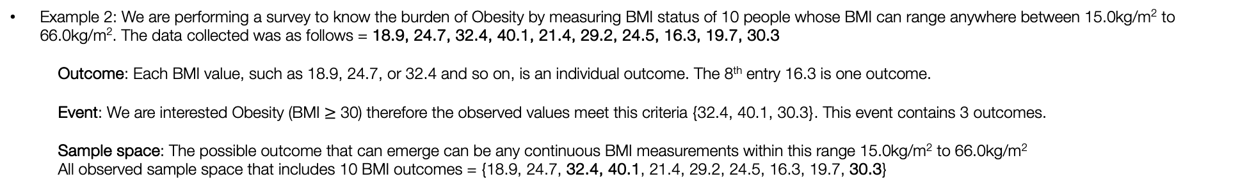
Social Data Institute
Basic terminology: event, outcome & sample space
In probability, the following means:
An outcome simply refers to a single result that can emerge from a study.
An event is referred to as the set of outcomes that share a common characteristic in a study.
A sample space is the set of all possible outcomes observed in a study.
Example 2: We are performing a survey to know the burden of Obesity by measuring BMI status of 10 people whose BMI can range anywhere between 15.0kg/m² to 66.0kg/m². The data collected was as follows = 18.9, 24.7, 32.4, 40.1, 21.4, 29.2, 24.5, 16.3, 19.7, 30.3
Outcome: Each BMI value, such as 18.9, 24.7, or 32.4 and so on, is an individual outcome. The 8th entry 16.3 is one outcome.
Event: We are interested Obesity (BMI $≥$ 30) therefore the observed values meet this criteria {32.4, 40.1, 30.3}. This event contains 3 outcomes.
Sample space: The possible outcome that can emerge can be any continuous BMI measurements within this range 15.0kg/m² to 66.0kg/m²
All observed sample space that includes 10 BMI outcomes = {18.9, 24.7, 32.4, 40.1, 21.4, 29.2, 24.5, 16.3, 19.7, 30.3}
Remember, Pr(E), the probability that an event ‘E’ will occur. This is what the notation for the above example will look like:
Probability that a person from this cohort is obese = Pr(Obesity)
17

Slide 18
Social Data Institute
Example 1: We are conducting a mosquito infestation survey in 7 households in a village. We want to know the probability that a house is infested with mosquitoes:
Event: The event “Infested” consists of all 3 outcomes (i.e., 1st, 5th and 7th home) that are infested
Sample space: All observed 7 outcomes = {Infested, Not Infested, Not Infested, Not Infested, Infested, Not Infested, Infested}
Example 2: We are performing a survey to know the burden of Obesity by measuring BMI status of 10 people. We want to know the probability that a person’s obese:
Event: This event contains 3 outcomes that meet the criteria of obesity status (BMI ≥ 30) i.e., {32.4, 40.1, 30.3}.
Sample space: All observed 10 BMI outcomes = {18.9, 24.7, 32.4, 40.1, 21.4, 29.2, 24.5, 16.3, 19.7, 30.3}
Probability that a house is infested with mosquitoes = Pr(Infested) = (set number of households infested/sample size) = 3/7 = 0.4285 = 42.85%
Probability that a person from this cohort is obese = Pr(Obesity) = (set number of students BMI$≥$30/sample size) = 3/10 = 0.30 = 30.00%
The above instance dealing with ‘single events’ are typical examples of an Unconditional Probability.
There are three major types of probabilities: Unconditional, Joint and Conditional probability.
18
Notes:
I am sure you folks are already aware of how to calculate a probability of a single event
Example of calculating a probability
There are three major types of probabilities

Slide 19
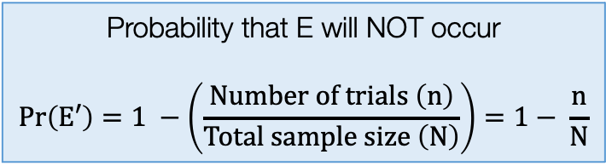
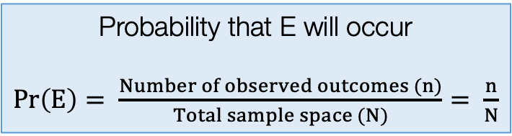
Social Data Institute
Unconditional Probabilities
An unconditional probability is the chance (or likelihood) that a particular event will occur, without regards to external events that occurred in the past, or present or in the future.
Usually, the set outcome of a single event can be affected by any number of factors; however, with unconditional probabilities, the likelihood of an event ending with a specific result does not account for other conditions that may affect it.
An Unconditional Probability is also called a ‘Marginal Probability’
When there’s data - unconditional (or marginal) probabilities are calculated accordingly as follows:
Note 1:
P(E) + P(E’) = 1
Note 2:
It is basic a prevalence or proportion value
Note 3:
Union (U) in set theory is also the total sample size
Probability that E will occur
$Pr\left(E\right)= \frac{Number of observed outcomes (n)}{Total sample space (N)}= \frac{n}{N}$
Probability that E will NOT occur
$$Pr\left(E′\right)=1 −\left(\frac{Number of trials \left(n\right)}{Total sample size \left(N\right)}\right)=1− \frac{n}{N}$$
We call this complement of E (i.e., E’)
19
Notes:
There are 4 major types of probabilities

Slide 20
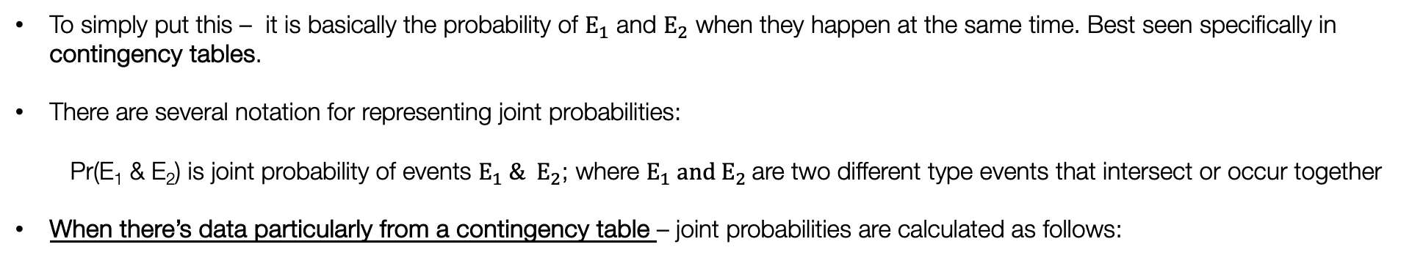
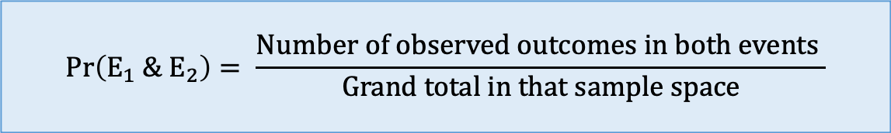
Social Data Institute
Joint Probabilities
A joint probability refers to the likelihood of more than one event occurring at the same time. For example, if there are two events i.e., $E_{1}$ and $E_{2}$, the joint probability is the chance that both events will occur at the same time.
To simply put this – it is basically the probability of $E_{1}$ and $E_{2}$ when they happen at the same time. Best seen specifically in contingency tables.
There are several notation for representing joint probabilities:
Pr(E₁ & E₂) is joint probability of events $E_{1} \& E_{2}$; where $E_{1} and E_{2}$are two different type events that intersect or occur together
When there’s data particularly from a contingency table – joint probabilities are calculated as follows:
$$Pr\left(E_{1} \&{ E}_{2}\right)= \frac{Number of observed outcomes in both events }{Grand total in that sample space}$$
20
Notes:
There is a special case for this, which is so confusing.

Slide 21
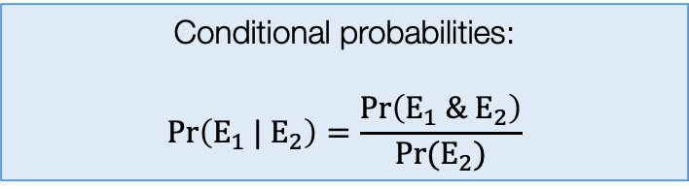
Social Data Institute
Conditional Probabilities
A conditional probability of an event $E_{1}$is the probability that $E_{1}$ will happen given that the event $E_{2}$ has already occurred.
Simply put – it’s the likelihood of an event E₁ occurring, based on the occurrence of a previous event E₂.
We say: “Probability of ‘this’ given ‘that’” – where the probability of event E₁ depends on the occurrence of event E₂
The notation for representing conditional probabilities using this symbol “|” to represent ‘given’. It is written as: Pr(E₁ | E₂) which means the probability of E₁ given E₂
Conditional probabilities are computed accordingly as follows:
Conditional probabilities:
$$Pr\left(E_{1} |{ E}_{2}\right)=\frac{Pr\left(E_{1} \& E_{2}\right)}{Pr⁡(E_{2})}$$
Notes: Calculating the conditional probabilities
are quite involved. You will need to calculated the
joint probabilities of E1 and E2, and unconditional
probability of E2 and divide them together.
21

Slide 22
Social Data Institute
Example: Study on measuring abundance of Adult mosquitoes in Location A [1]
 | Breeding sites: Aedes | Breeding sites: No Aedes | Sum (Row)
Urban | 182 | 1008 | 1190
Rural | 132 | 861 | 993
Sum (Column) | 314 | 1869 | Grand total: 2183
We are interested detected presence of adult mosquitoes from breeding sites within an urban or rural setting
Let the B represent the event Breeding sites: Aedes
Let the B’ represent the event Breeding sites: No Aedes
Let the U represent the event urban area (i.e., total number of breeding sites found in an urban setting)
Let the U’ represent the event rural area (i.e., total number of breeding sites found in a rural setting)
Unconditional Probabilities
Joint Probabilities
22
Conditional Probabilities

Slide 23
Social Data Institute
Example: Study on measuring abundance of Adult mosquitoes in Location A [2]
 | Breeding sites: Aedes | Breeding sites: No Aedes | Sum (Row)
Urban | 182 | 1008 | 1190 (/2183)
Rural | 132 | 861 | 993 (/2183)
Sum (Column) | 314 (/2183) | 1869 (/2183) | Grand total: 2183
Here, we can compute the probabilities by simply dividing the number of events observed by the overall total sample space which is 2183
The second table, we have simply converted the raw values to probabilities. The light blue shaded cells are the unconditional (or marginal) probabilities
 | Breeding sites: Aedes (B) | Breeding sites: No Aedes (B’) | Sum (Row)
Urban (U) |  |  | 0.55 P(U)
Rural (U’) |  |  | 0.45 P(U’)
Sum (Column) | 0.14 P(B) | 0.86 P(B’) | Grand total: 1
Probability of finding breeding site
in Urban location = 0.55
Probability of finding breeding site
in Rural location = 0.45
Unconditional Probabilities
Probability of finding breeding site
with Aedes mosquito = 0.14
Probability of finding breeding site
with no Aedes mosquito = 0.86
23

Slide 24
Social Data Institute
Example: Study on measuring abundance of Adult mosquitoes in Location A [2]
 | Breeding sites: Aedes | Breeding sites: No Aedes | Sum (Row)
Urban | 182 | 1008 | 1190 (/2183)
Rural | 132 | 861 | 993 (/2183)
Sum (Column) | 314 (/2183) | 1869 (/2183) | Grand total: 2183
 | Breeding sites: Aedes (B) | Breeding sites: No Aedes (B’) | Sum (Row)
Urban (U) | B & U | B’ & U | 0.55 P(U)
Rural (U’) | B & U’ | B’ & U’ | 0.45 P(U’)
Sum (Column) | 0.14 P(B) | 0.86 P(B’) | Grand total: 1
24
Joint Probabilities

Slide 25
Social Data Institute
Example: Study on measuring abundance of Adult mosquitoes in Location A [3]
 | Breeding sites: Aedes | Breeding sites: No Aedes | Sum (Row)
Urban | 182 (/2183) | 1008 (/2183) | 1190
Rural | 132 (/2183) | 861(/2183) | 993
Sum (Column) | 314 | 1869 | Grand total: 2183
In the second table, we can convert these raw values to joint probabilities. The dark blue shaded cells are the joints probabilities computed by using the formula shown in slide #20
 | Breeding sites: Aedes (B) | Breeding sites: No Aedes (B’) | Sum (Row)
Urban (U) | 0.0834 Pr(B & U) | 0.4617 Pr(B’ & U) | 0.55 Pr(U)
Rural (U’) | 0.0605 Pr(B & U’) | 0.3944 Pr(B’ & U’) | 0.45 Pr(U’)
Sum (Column) | 0.14 Pr(B) | 0.86 Pr(B’) | Grand total: 1
Probability of finding a breeding
site with Aedes mosquitoes in
rural areas = 0.0605 (6.05%)
Probability of finding a breeding
site with no Aedes mosquitoes in
rural areas = 0.3944 (39.44%)
25
Joint Probabilities

Slide 26
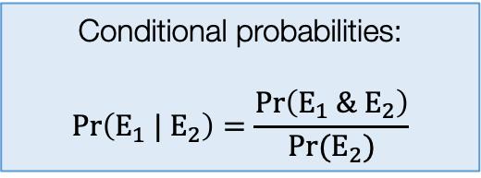
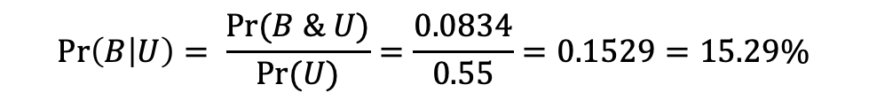
Social Data Institute
Example: Study on measuring abundance of Adult mosquitoes in Location A [3]
 | Breeding sites: Aedes | Breeding sites: No Aedes | Sum (Row)
Urban | 182 | 1008 | 1190
Rural | 132 | 861 | 993
Sum (Column) | 314 | 1869 | Grand total: 2183
Suppose, we want to know what the probability that that Aedes mosquito are present in breeding sites given the setting is urban i.e., Pr(B|U), a conditional probability.
We will need the joint probability Pr(B & U)
We will need the unconditional probability for Pr(U)
 | Breeding sites: Aedes (B) | Breeding sites: No Aedes (B’) | Sum (Row)
Urban (U) | 0.0834 Pr(B & U) | 0.4617 Pr(B’ & U) | 0.55 Pr(U)
Rural (U’) | 0.0605 Pr(B & U’) | 0.3944 Pr(B’ & U’) | 0.45 Pr(U’)
Sum (Column) | 0.14 Pr(B) | 0.86 Pr(B’) | Grand total: 1
Conditional probabilities:
$$Pr\left(E_{1} |{ E}_{2}\right)=\frac{Pr\left(E_{1} \& E_{2}\right)}{Pr⁡(E_{2})}$$
$$\operatorname{Pr}\left(B | U\right)= \frac{Pr⁡(B \& U)}{Pr⁡(U)}=\frac{0.0834}{0.55}=0.1529=15.29\%$$
26
Conditional Probabilities

Slide 27
Basic Probabilities
Probability Distribution
Bayes’ Rule
Bayesian Inference
27

Slide 28
Probability Distributions
28
Notes:
We use

Slide 29
Social Data Institute
Definition:
Probability distribution is a mathematical function that estimates the plausibility (or frequency) of observing a particular value (or range of values) for a variable. It can be used to estimate cumulative probability up to a certain value.
There are broadly two groups for probability distributions with several subtypes:
Probability Mass Function (PMFs) (Discrete)
Discrete uniform distribution
Bernoulli distribution
Binomial distribution*
Poisson distribution
Probability Density Function (PDFs) (Continuous)
Uniform distribution
Gaussian (or Normal) distribution (flexible)*
Gamma distribution (flexible)*
Beta distribution (flexible)*
Cauchy distribution (flexible)
Note: These distributions can handle variables that are continuous in nature. First estimates the plausibility (density).
Note: These distributions can handle variables that counts, or a discrete (or distinct) in nature. Directly estimates the
probability.
Important note:
In Bayesian inference, we will have to apply probability distributions to the various conditional and marginal probability components (i.e., likelihood function and prior probability, respectively) of the Bayes’ rule formula to derive the posterior probability.
We impose a probability distribution to model an outcome (likelihood), while we subjectively choose another probability distribution (according to our believes aka priors) that best describes the shape of the parameters before observing the data
29

Slide 30
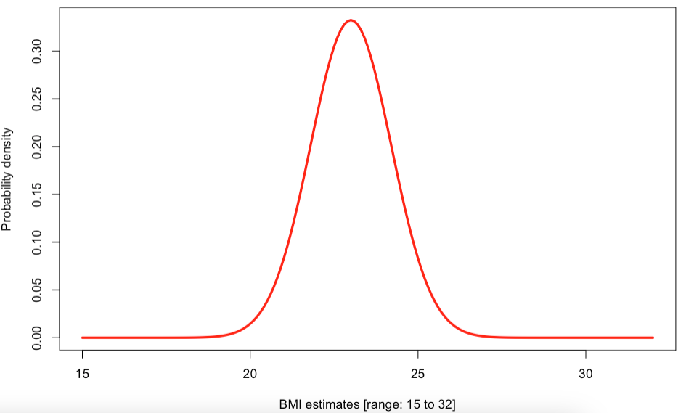
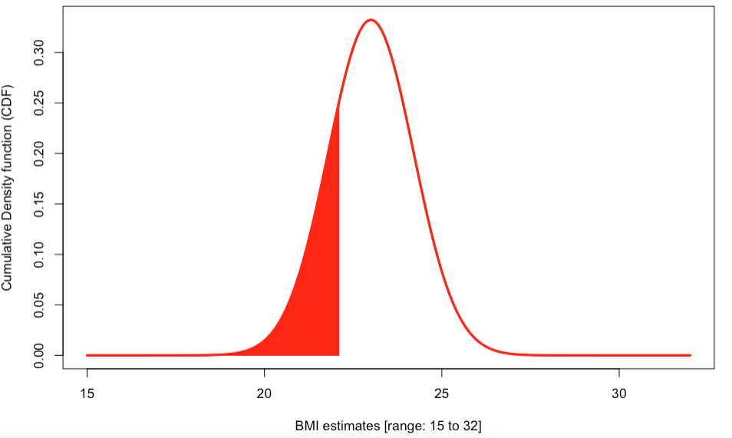
Understanding the features of probability distribution [1]
[1] Point values
[2] Areas under a curve
Value 3 has the highest plausibility (most likely value)
Value 2 is highly plausible
Value 2 is highly plausible
Probability Density (Plausibility)
Probability Density (Plausibility)
Red portion under this curve is called a “Cumulative probability”
Pr(Outcome < Value 2)
White portion under this curve is called an “Exceedance probability”
Pr(Outcome > Value 2)
Value 1 has the lowest plausibility
Value 1
Value 2
Value 3
Value 2
Continuous Outcome
Continuous Outcome
This plot tell us the probability density (or plausibility) associated with the most (or least) likely or frequent
The shaded area under the curve in this plot tells us the actual probability for observing a particular value i.e., Pr(Outcome < Value 2). From a distribution with a continuous outcome, if you want to calculate a probability – some shaded portion under this curve must be calculated.
30

Slide 31
Understanding the features of probability distribution [2]
[3] Spread (or variation)
[4] Heavy-tailed
Value 3 has the highest plausibility (most likely value)
Curve 1 (Heaviest tailed)
Probability Density (Plausibility)
Probability Density (Plausibility)
Curve 2 (Heavy tailed)
Curve 1 (Broadest)
Curve 3 (Thin tailed)
Curve 2 (Modest)
Curve 3 (Narrow)
Value 3
Continuous Outcome
Continuous Outcome
This plot tell us how widely the values in a distribution are dispersed, and so broader curves
indicate more variation (e.g., curve 1), while narrower curves show less (e.g., curve 3). Or one can say the following: ‘the wider the curve, the greater the variation, the narrower the curve, the more tightly values cluster around the centre’.
This plot tell us where a heavy tail exist in a distribution. A heavy-tailed distribution is one that gives more plausibility to extreme values. For instance, curve 3 has extreme values that highly unlikely because it’s a thinned tail, while curve 1 – there’s some plausibility (though small) in its extreme values
31

Slide 32
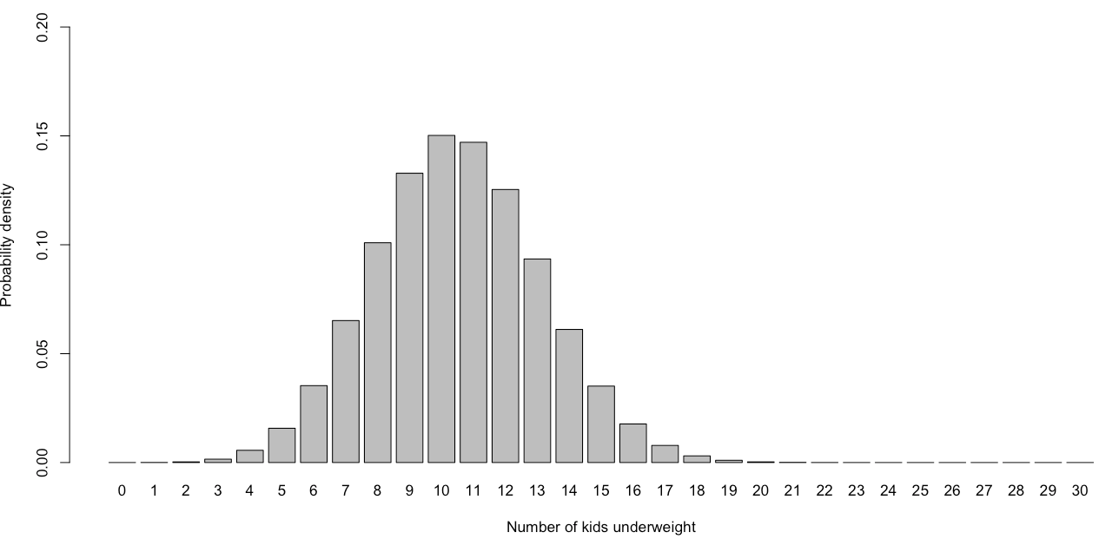
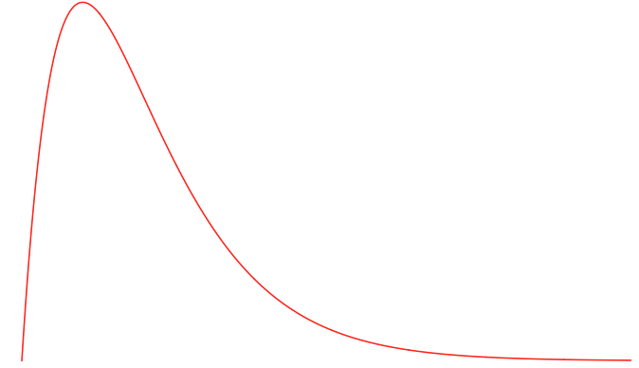
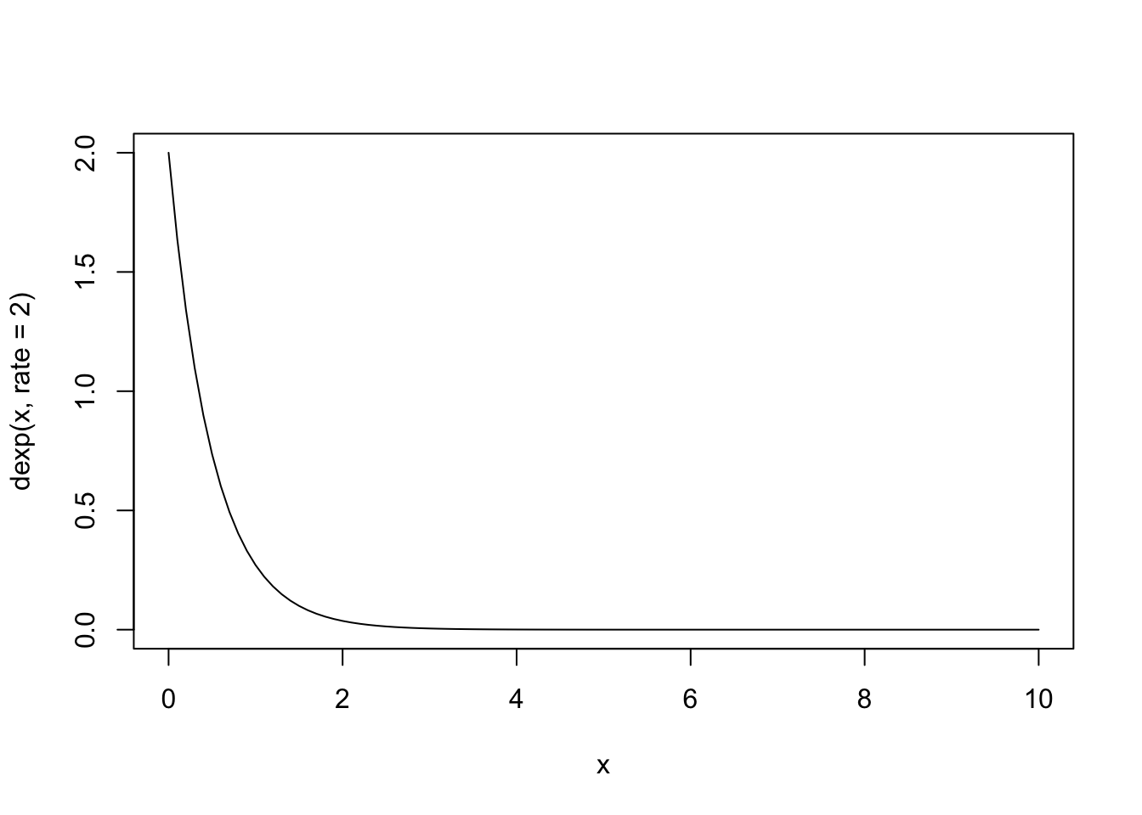
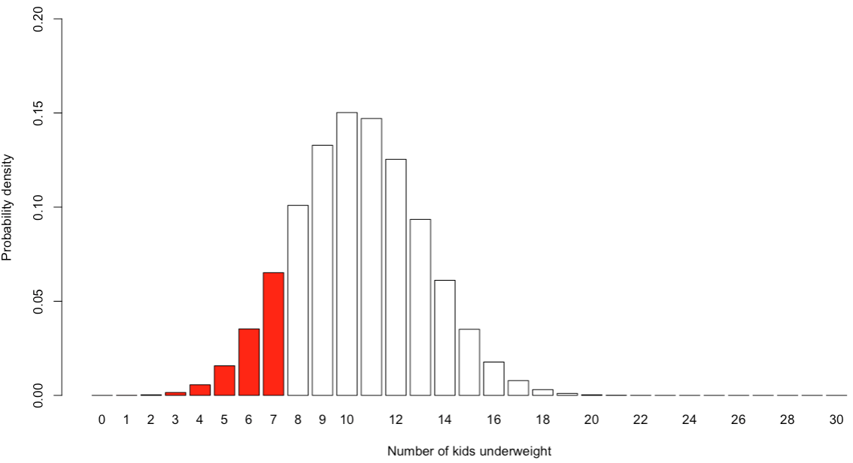
Understanding the features of probability distribution [3]
[5] Shape
[6] Discrete case (Unique)
Value 1 (most likely value)
Unlike the continuous case – the probability distributions for discrete values
automatically gives you probability for point values (discrete), because you are
calculating its from an area for a rectangle
Probability (%)
Pr(7 kids are underweight) = 0.0659 or 6.59%
Probability Density (Plausibility)
Depending on the type of probability distribution, or data, they all come in different ‘shapes’ and ‘sizes’
Unlike the continuous case – instead of calculate the area under the curve, we sum the shaded areas up for each rectangle to get the probability of “at most, 7 kids being underweight
Probability (%)
Pr(at most 7 kids are underweight) = 0.124 or 12.4%
Value 1
Continuous Outcome
This plot tell us that probability distributions can take on many different shapes. For instance, some can be symmetric or asymmetric, some are skewed, and some have more than one peak. The shape, spread, and type of data offer important clues about which distribution a dataset may follow - main image is an example of a Gamma or Beta distribution.
32

Slide 33
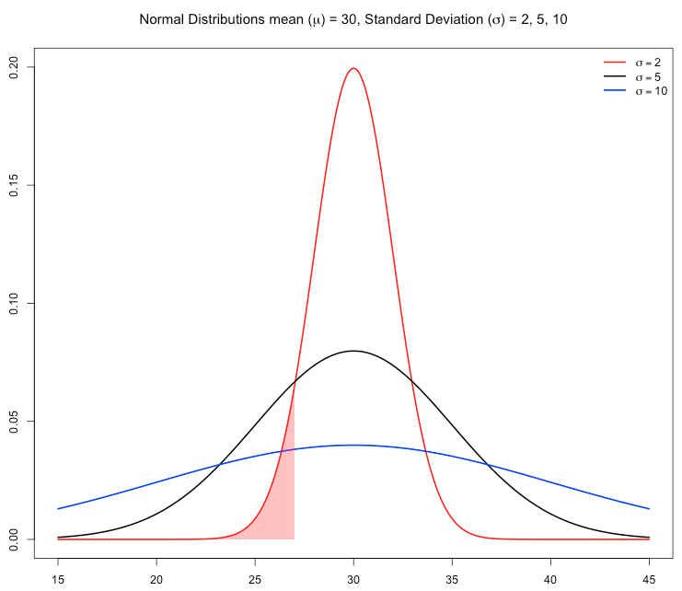
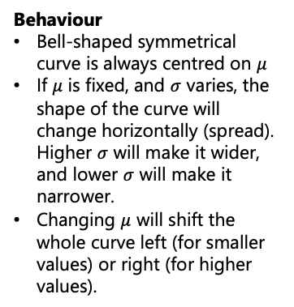
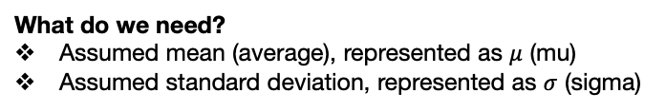
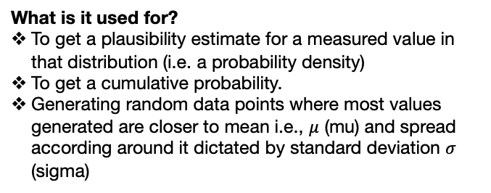
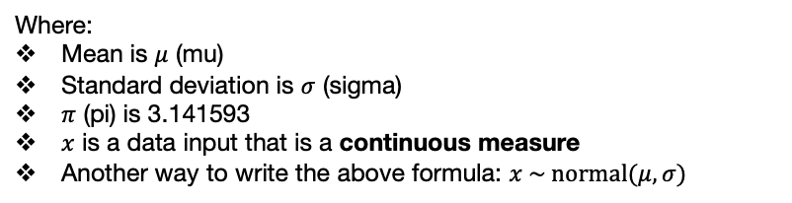
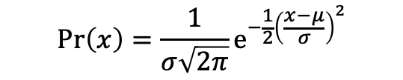
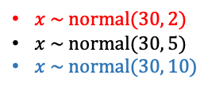
How do probability distributions work?
Gaussian (or Normal) Distribution [1]
What is it?
It characterised by a bell-shaped symmetrical curve for continuous data where most values around the mean (or average), and the farther you move from that average (either higher or lower on the spectrum of values) the fewer values you’ll find.
$x \sim normal(30, 2)$
$x \sim normal(30, 5)$
$x \sim normal(30, 10)$
Behaviour
Bell-shaped symmetrical curve is always centred on $μ$
If $μ$ is fixed, and $σ$ varies, the shape of the curve will change horizontally (spread). Higher $σ$ will make it wider, and lower $σ$ will make it narrower.
Changing $μ$ will shift the whole curve left (for smaller values) or right (for higher values).
What do we need?
Assumed mean (average), represented as $μ$ (mu)
Assumed standard deviation, represented as $σ$ (sigma)
Probability Density (Plausibility)
What is the formulation?
$$Pr\left(x\right)=\frac{1}{σ\sqrt{2π}}e^{−\frac{1}{2}{\left(\frac{x−μ}{σ}\right)}^{2}}$$
Where:
Mean is $μ$ (mu)
Standard deviation is $σ$ (sigma)
$π$ (pi) is 3.141593
$x$ is a data input that is a continuous measure
Another way to write the above formula: $x \sim normal(μ,σ)$
x
What is it used for?
To get a plausibility estimate for a measured value in that distribution (i.e. a probability density)
To get a cumulative probability.
Generating random data points where most values generated are closer to mean i.e., $μ$ (mu) and spread according around it dictated by standard deviation $σ$ (sigma)
Important note: Understanding behaviour of a probability distribution is a vital when doing Bayesian inference, particularly in the specification of priors (i.e., inputting our own subjective belief or knowledge before observing the data).
When use a normal distribution as a prior, and state the mean, you are saying that “you believe that values are concentrated around the value of 30, where that 30 is the most likely”. Where you state the standard deviation (e.g., 2) in this distribution, you are saying that “you believe that the range around 30 is between 28 and 32 (1-SD) (or alternatively approximately between 24 and 36 (3-SD))”.
33

Slide 34

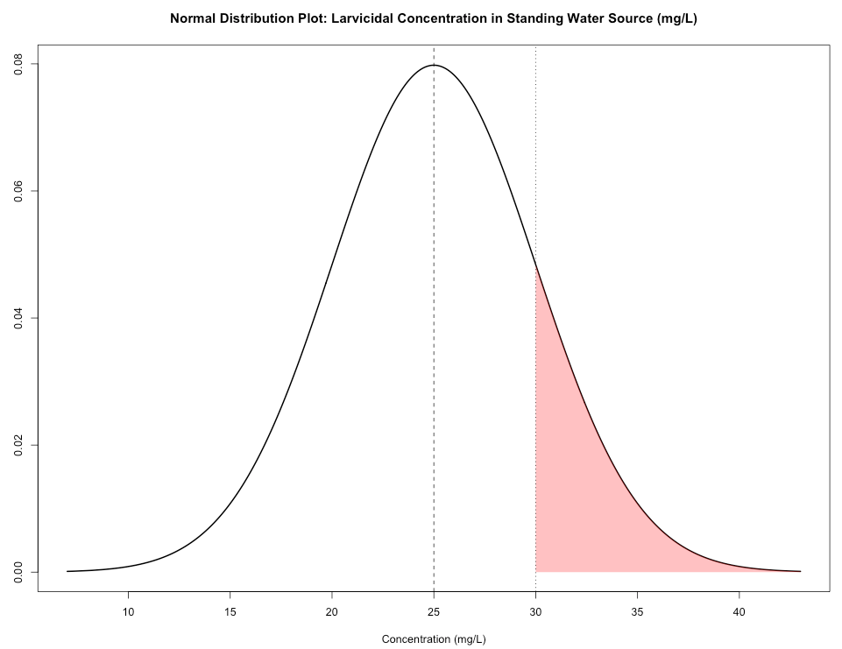
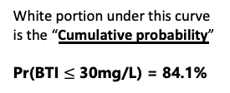
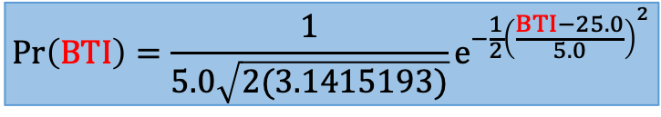
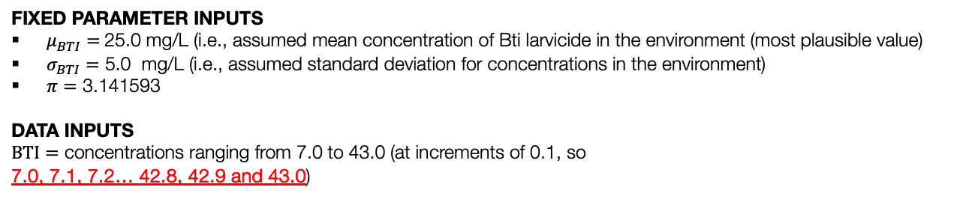
How do probability distributions work?
Gaussian (or Normal) Distribution [2]
Example using the Normal Distribution for computing plausibility of an observed value, and cumulative or exceedance probability
FIXED PARAMETER INPUTS
$μ_{BTI}=$25.0 mg/L (i.e., assumed mean concentration of Bti larvicide in the environment (most plausible value)
$σ_{BTI}=$ 5.0 mg/L (i.e., assumed standard deviation for concentrations in the environment)
$π=$ 3.141593
DATA INPUTS
$BTI=$ concentrations ranging from 7.0 to 43.0 (at increments of 0.1, so
7.0, 7.1, 7.2… 42.8, 42.9 and 43.0)
Monitoring the environmental concentrations of Bti larvicide dunks in standing water to prevent mosquito breeding hotspots in Brazil (Source: CDC)
Each value in this range is inserted into this formula to get a plausibility value.
$$Pr\left(BTI\right)=\frac{1}{5.0\sqrt{2(3.1415193)}}e^{−\frac{1}{2}{\left(\frac{BTI−25.0}{5.0}\right)}^{2}}$$
It generates this curve
Probability Density (Plausibility)
Interpretation: We can estimate how plausible it is for BTI levels to be exactly 30 mg/L. This value of 0.0483 represents the likelihood of BTI being 30 mg/L relative to all other BTI values in the distribution. Again, it NOT a probability nor percentage – it’s a measure for plausibility.
The probability of BTI levels being up to 30 mg/L in the environment is 0.841 (84.1%). The probability that BTI levels are over 30 mg/L in the environment is 0.159 (15.9%).
White portion under this curve is the “Cumulative probability”
Pr(BTI $≤$ 30mg/L) = 84.1%
Red portion under this curve is the “Exceedance probability”
Pr(BTI > 30mg/L) = 15.9%
34

Slide 35
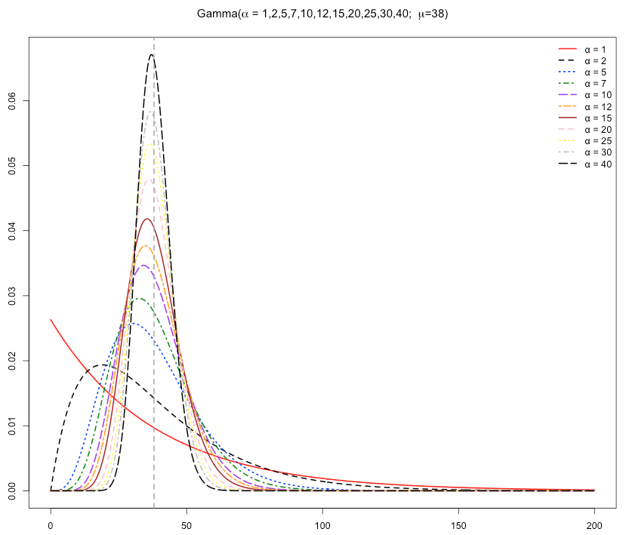
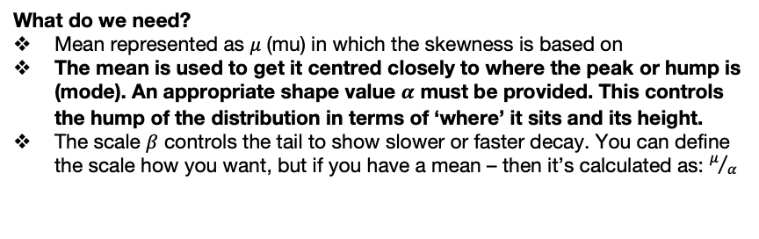
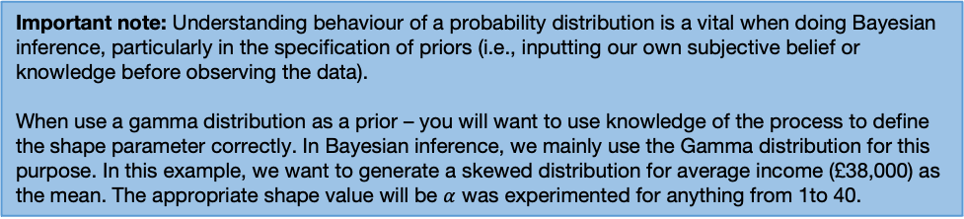
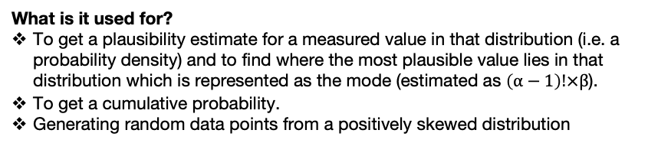
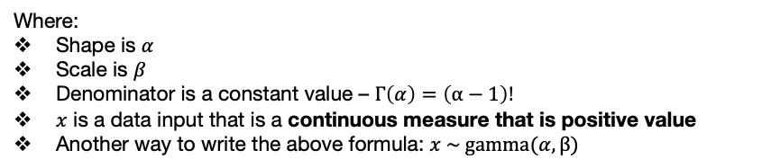
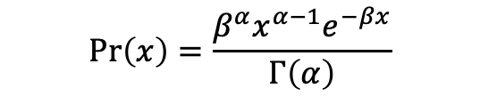
How do probability distributions work?
Gamma Distribution [1]
What is it?
It characterised by a smooth curve for continuous data are only positive values. It is a distribution best for describing positively right skewed information. You can control its shape and scale of the gamma distribution.
What do we need?
Mean represented as $μ$ (mu) in which the skewness is based on
The mean is used to get it centred closely to where the peak or hump is (mode). An appropriate shape value $α$ must be provided. This controls the hump of the distribution in terms of ‘where’ it sits and its height.
The scale $β$ controls the tail to show slower or faster decay. You can define the scale how you want, but if you have a mean – then it’s calculated as: $μ/α$
Probability Density (Plausibility)
What is the formulation?
$$Pr\left(x\right)=\frac{β^{α}x^{α−1}e^{−βx}}{Γ\left(α\right)}$$
Where:
Shape is $α$
Scale is $β$
Denominator is a constant value – $Γ\left(α\right)=\left(α−1\right)!$
$x$ is a data input that is a continuous measure that is positive value
Another way to write the above formula: $x \sim gamma(α,β)$
£38K
Average annual income in UK 2024 (in 000’s)
Important note: Understanding behaviour of a probability distribution is a vital when doing Bayesian inference, particularly in the specification of priors (i.e., inputting our own subjective belief or knowledge before observing the data).
When use a gamma distribution as a prior – you will want to use knowledge of the process to define the shape parameter correctly. In Bayesian inference, we mainly use the Gamma distribution for this purpose. In this example, we want to generate a skewed distribution for average income (£38,000) as the mean. The appropriate shape value will be $α$ was experimented for anything from 1to 40.
What is it used for?
To get a plausibility estimate for a measured value in that distribution (i.e. a probability density) and to find where the most plausible value lies in that distribution which is represented as the mode (estimated as $\left(α−1\right)!×β$).
To get a cumulative probability.
Generating random data points from a positively skewed distribution
35

Slide 36
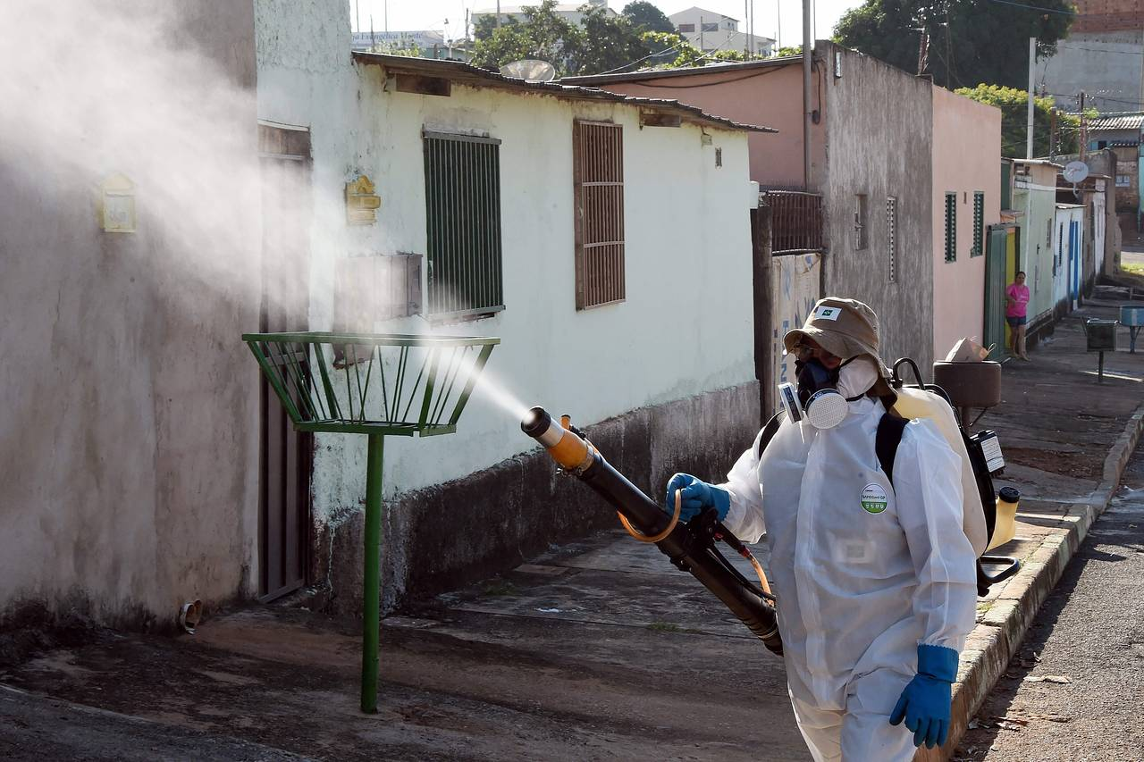
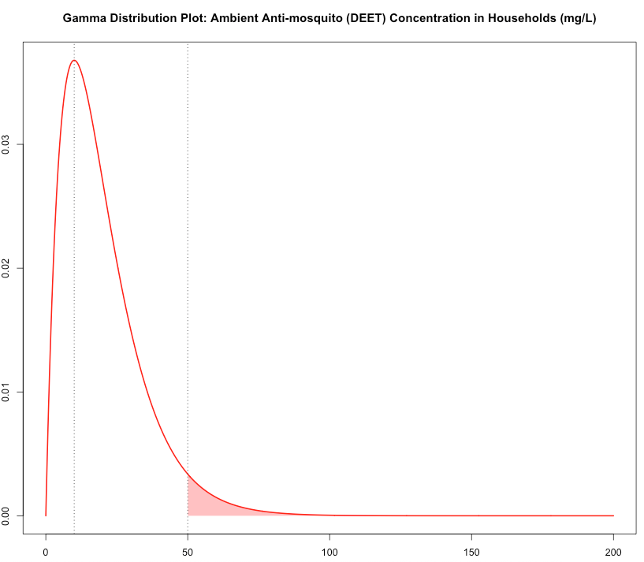
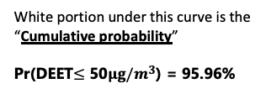
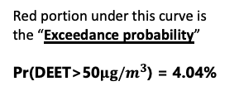
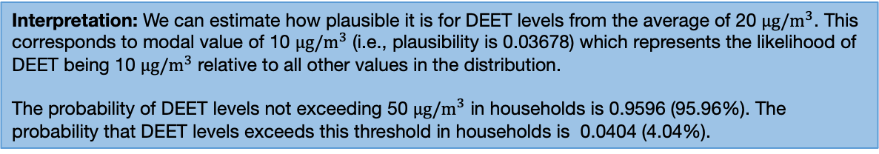
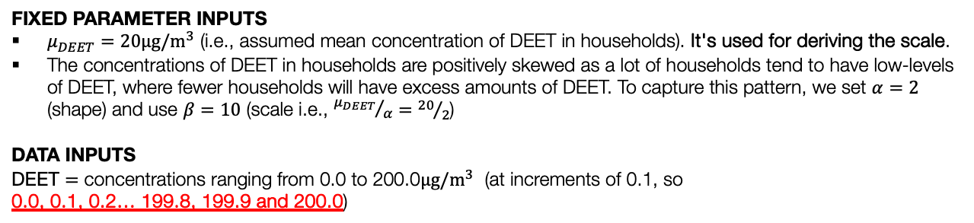

How do probability distributions work?
Gamma Distribution [2]
Example using the Gamma Distribution for computing plausibility of an observed value, and cumulative or exceedance probability
FIXED PARAMETER INPUTS
$μ_{DEET}=20μg/m^{3}$ (i.e., assumed mean concentration of DEET in households). It's used for deriving the scale.
The concentrations of DEET in households are positively skewed as a lot of households tend to have low-levels of DEET, where fewer households will have excess amounts of DEET. To capture this pattern, we set $α=2$ (shape) and use $β=10$ (scale i.e., ${μ_{DEET}}/α={20}/2$)
DATA INPUTS
DEET $=$ concentrations ranging from 0.0 to 200.0$μg/m^{3}$ (at increments of 0.1, so
0.0, 0.1, 0.2… 199.8, 199.9 and 200.0)
Monitoring the ambient chemical concentrations of anti-mosquito repellents (DEET) in households after application to outdoor airspace in Sao Paula, Brazil (Source: Wall Street Journal)
Each value in this range is inserted into this formula to get a plausibility value.
$$Pr\left(DEET\right)=\frac{{10}^{2}×{DEET}^{2−1}×e^{−10(DEET)}}{\left(2−1\right)!}$$
It generates this curve
Probability Density (Plausibility)
White portion under this curve is the “Cumulative probability”
Pr(DEET$≤$ 50$μg/m^{3}$) = 95.96%
Interpretation: We can estimate how plausible it is for DEET levels from the average of 20 $μg/m^{3}$. This corresponds to modal value of 10 $μg/m^{3}$ (i.e., plausibility is 0.03678) which represents the likelihood of DEET being 10 $μg/m^{3}$ relative to all other values in the distribution.
The probability of DEET levels not exceeding 50 $μg/m^{3}$ in households is 0.9596 (95.96%). The probability that DEET levels exceeds this threshold in households is 0.0404 (4.04%).
Red portion under this curve is the “Exceedance probability”
Pr(DEET>50$μg/m^{3}$) = 4.04%
36

Slide 37




How do probability distributions work?
What is the formulation?
Beta Distribution [1]
$$Pr\left(p\right)=\frac{p^{α−1}{(1−p)}^{β−1}}{B\left(α,β\right)}$$
What is it?
It characterised by a smooth curve for continuous data that are positive values between 0 and 1, inclusively. It is a distribution best for describing proportions with unknown numerator and/or denominator. You can control its shape and location of the Beta distribution.
Where:
Shape is $α$
Shape is $β$
Denominator is a constant value – $B\left(α,β\right)=\frac{\left(α−1\right)!\left(β−1\right)! }{\left(α+β−1\right)! }$
$p$ is a data input that is a continuous measure that lies between 0 and 1, inclusively – it is a proportion (percentage).
Another way to write the above formula: $p \sim beta(α,β)$
What do we need?
Scenario 1: You need to specify both $α$ and $β$. When $α$is greater than $β$, the resulting distribution is that of a negatively skewed distribution. If you assume higher proportion values closer to 1 (i.e., 100%) to be more plausible – then let $α$be greater than $β.$
Scenario 2: You need to specify both $α$ and $β$. When$β$ is greater than$α$, the resulting distribution is that of a positively skewed distribution. If you assume lower proportion values closer to 0 (i.e., 0%) to be more plausible – let $β$ be greater than $α.$
Scenario 3: You need to specify both $α$ and $β$. When $α$is equal to $β$, and increasing both at the same time, the resulting distribution starts of as a uniform distribution and then converges to that which is akin to a normal distribution. Uniform – every value for the proportion is equally plausible; while as both parameters increase in the same way – we assume that the proportion of 50% became more and more plausible$.$
Scenario 4: When you have a specific value for the proportion which you want the Beta distribution to be centred on – you will have to solve for both $α$ and $β$! Meaning that you will need to specify an assumed mean value ($μ$) for the proportion and a small value for the standard deviation ($σ$).
$$β=μ−1+\left[\frac{μ×{\left(1−μ\right)}^{2}}{σ^{2}}\right]$$
$$α=\frac{β×μ}{(1−μ)}$$
Probability Density (Plausibility)
37

Slide 38


How do probability distributions work?
What is the formulation?
Beta Distribution [2]
$$Pr\left(p\right)=\frac{p^{α−1}{(1−p)}^{β−1}}{B\left(α,β\right)}$$
What is it?
It characterised by a smooth curve for continuous data that are positive values between 0 and 1, inclusively. It is a distribution best for describing proportions with unknown numerator and/or denominator. You can control its shape and location of the Beta distribution.
Where:
Shape is $α$
Shape is $β$
Denominator is a constant value – $B\left(α,β\right)=\frac{\left(α−1\right)!\left(β−1\right)! }{\left(α+β−1\right)! }$
$p$ is a data input that is a continuous measure that lies between 0 and 1, inclusively – it is a proportion (percentage).
Another way to write the above formula: $p \sim beta(α,β)$
What do we need?
Scenario 1: You need to specify both $α$ and $β$. When $α$is greater than $β$, the resulting distribution is that of a negatively skewed distribution. If you assume higher proportion values closer to 1 (i.e., 100%) to be more plausible – let $α$be greater than $β.$
Scenario 2: You need to specify both $α$ and $β$. When$β$ is greater than$α$, the resulting distribution is that of a positively skewed distribution. If you assume lower proportion values closer to 0 (i.e., 0%) to be more plausible – then let $β$ be greater than $α.$
Scenario 3: You need to specify both $α$ and $β$. When $α$is equal to $β$, and increasing both at the same time, the resulting distribution starts of as a uniform distribution and then converges to that which is akin to a normal distribution. Uniform – every value for the proportion is equally plausible, while as both parameters increase in the same way, we assume that the proportion of 50% became more and more plausible$.$
Scenario 4: When you have a specific value for the proportion which you want the Beta distribution to be centred on – you will have to solve for both $α$ and $β$! Meaning that you will need to specify an assumed mean value ($μ$) for the proportion and a small value for the standard deviation ($σ$).
$$β=μ−1+\left[\frac{μ×{\left(1−μ\right)}^{2}}{σ^{2}}\right]$$
$$α=\frac{β×μ}{(1−μ)}$$
Probability Density (Plausibility)
38

Slide 39


How do probability distributions work?
What is the formulation?
Beta Distribution [3]
$$Pr\left(p\right)=\frac{p^{α−1}{(1−p)}^{β−1}}{B\left(α,β\right)}$$
What is it?
It characterised by a smooth curve for continuous data that are positive values between 0 and 1, inclusively. It is a distribution best for describing proportions with unknown numerator and/or denominator. You can control its shape and location of the Beta distribution.
Where:
Shape is $α$
Shape is $β$
Denominator is a constant value – $B\left(α,β\right)=\frac{\left(α−1\right)!\left(β−1\right)! }{\left(α+β−1\right)! }$
$p$ is a data input that is a continuous measure that lies between 0 and 1, inclusively – it is a proportion (percentage).
Another way to write the above formula: $p \sim beta(α,β)$
What do we need?
Scenario 1: You need to specify both $α$ and $β$. When $α$is greater than $β$, the resulting distribution is that of a negatively skewed distribution. If you assume higher proportion values closer to 1 (i.e., 100%) to be more plausible – let $α$be greater than $β.$
Scenario 2: You need to specify both $α$ and $β$. When$β$ is greater than$α$, the resulting distribution is that of a positively skewed distribution. If you assume lower proportion values closer to 0 (i.e., 0%) to be more plausible – then let $β$ be greater than $α.$
Scenario 3: You need to specify both $α$ and $β$. When $α$is equal to $β$, and increasing both at the same time, the resulting distribution starts of as a uniform distribution and then converges to that which is akin to a normal distribution. Uniform – every value for the proportion is equally plausible, while as both parameters increase in the same way, we assume that the proportion of 50% became more and more plausible$.$
Scenario 4: When you have a specific value for the proportion which you want the Beta distribution to be centred on – you will have to solve for both $α$ and $β$! Meaning that you will need to specify an assumed mean value ($μ$) for the proportion and a small value for the standard deviation ($σ$).
$$β=μ−1+\left[\frac{μ×{\left(1−μ\right)}^{2}}{σ^{2}}\right]$$
$$α=\frac{β×μ}{(1−μ)}$$
Probability Density (Plausibility)
39

Slide 40

How do probability distributions work?
What is the formulation?
Beta Distribution [4]
$$Pr\left(p\right)=\frac{p^{α−1}{(1−p)}^{β−1}}{B\left(α,β\right)}$$
What is it?
It characterised by a smooth curve for continuous data that are positive values between 0 and 1, inclusively. It is a distribution best for describing proportions with unknown numerator and/or denominator. You can control its shape and location of the Beta distribution.
Where:
Shape is $α$
Shape is $β$
Denominator is a constant value – $B\left(α,β\right)=\frac{\left(α−1\right)!\left(β−1\right)! }{\left(α+β−1\right)! }$
$p$ is a data input that is a continuous measure that lies between 0 and 1, inclusively – it is a proportion (percentage).
Another way to write the above formula: $p \sim beta(α,β)$
What do we need?
Scenario 1: You need to specify both $α$ and $β$. When $α$is greater than $β$, the resulting distribution is that of a negatively skewed distribution. If you assume higher proportion values closer to 1 (i.e., 100%) to be more plausible – let $α$be greater than $β.$
Scenario 2: You need to specify both $α$ and $β$. When$β$ is greater than$α$, the resulting distribution is that of a positively skewed distribution. If you assume lower proportion values closer to 0 (i.e., 0%) to be more plausible – then let $β$ be greater than $α.$
Scenario 3: You need to specify both $α$ and $β$. When $α$is equal to $β$, and increasing both at the same time, the resulting distribution starts of as a uniform distribution and then converges to that which is akin to a normal distribution. Uniform – every value for the proportion is equally plausible, while as both parameters increase in the same way, we assume that the proportion of 50% became more and more plausible$.$
Scenario 4: When you have a specific value for the proportion which you want the Beta distribution to be centred on – you will have to solve for both $α$ and $β$! Meaning that you will need to specify an assumed mean value ($μ$) for the proportion and a small value for the standard deviation ($σ$).
$$β=μ−1+\left[\frac{μ×{\left(1−μ\right)}^{2}}{σ^{2}}\right]$$
$$α=\frac{β×μ}{(1−μ)}$$
Probability Density (Plausibility)
40

Slide 41





How do probability distributions work?
FIXED INPUTS
Before survey
$p=$ 0.35 (i.e., prior knowledge of prevalence household infestation in a particular neighbourhood)
After survey
$infested (y)=$ There are 7 households infested
$total(n)=$ There are 30 households in total surveyed
INPUTS
$infested (y)=$ 0 to 30 (maximum) (i.e., 0, 1, 2, 3, …, 27, 28, 29 and 30)
Binomial Distribution [1]
What is it?
It characterised as a histogram or barplot for discrete data that are positive values. It is a distribution best for describing proportions with known values for the numerator and denominator where the former represents successes, and the latter is a total.
Each value in this range is inserted into this formula to get a probability estimate.
What do we need?
We need to specify the assumed proportion (or percentage) about the outcome, represented as $p$
We need to know the observed total – this is drawn from the dataset once the outcome has been observed. This is represented as $n$
We need to know the observed number of successes $y$(e.g., people diseased, damage items from a cargo etc.,) from the total $n$
$$Pr\left(infested\right)= \left(\begin{matrix}30 \\ infested\end{matrix}\right){0.35}^{infested}{\left(1−0.35\right)}^{30−infested}$$
What is the formulation?
$$Pr\left(y\right)= \left(\begin{matrix}n \\ y\end{matrix}\right)p^{y}{\left(1−p\right)}^{n−y}$$
Where:
The assumed proportion $p$
The total is represented as $n$
The number of successes $y$ (from the total of $n$)
Combinatorial notation which computes the total number of different ways (combinations) of observing the number of successes $y$ (from the total of $n$): $\left(\begin{matrix}n \\ y\end{matrix}\right)=$ $\frac{n!}{y!\left(n−y\right)!}$
Another way to write the above formula: $y \sim binomial(n,p)$
Probability
What is it used for?
To directly get a probability estimate for specific value of the discrete outcome. No plausibility here!
To get a cumulative mass probability.
Generating random data points that represents the number of successes from a binomial distribution
The probability of 7 households being infested with mosquitoes is 0.0652 (6.52%).
41

Slide 42


How do probability distributions work?
FIXED INPUTS
Before survey
$p=$ 0.35 (i.e., prior knowledge of prevalence household infestation in a particular neighbourhood)
After survey
$infested (y)=$ There are 7 households infested
$total(n)=$ There are 30 households in total surveyed
INPUTS
$infested (y)=$ 0 to 30 (maximum) (i.e., 0, 1, 2, 3, …, 27, 28, 29 and 30)
Binomial Distribution [2]
What is it?
It characterised as a histogram or barplot for discrete data that are positive values. It is a distribution best for describing proportions with known values for the numerator and denominator where the former represents successes, and the latter is a total.
Each value in this range is inserted into this formula to get a probability estimate.
What do we need?
We need to specify the assumed proportion (or percentage) about the outcome, represented as $p$
We need to know the observed total – this is drawn from the dataset once the outcome has been observed. This is represented as $n$
We need to know the observed number of successes $y$(e.g., people diseased, damage items from a cargo etc.,) from the total $n$
$$Pr\left(infested\right)= \left(\begin{matrix}30 \\ infested\end{matrix}\right){0.35}^{infested}{\left(1−0.35\right)}^{30−infested}$$
What is the formulation?
$$Pr\left(y\right)= \left(\begin{matrix}n \\ y\end{matrix}\right)p^{y}{\left(1−p\right)}^{n−y}$$
Where:
The assumed proportion $p$
The total is represented as $n$
The number of successes $y$ (from the total of $n$)
Combinatorial notation which computes the total number of different ways (combinations) of observing the number of successes $y$ (from the total of $n$): $\left(\begin{matrix}n \\ y\end{matrix}\right)=$ $\frac{n!}{y!\left(n−y\right)!}$
Another way to write the above formula: $y \sim binomial(n,p)$
What is it used for?
To directly get a probability estimate for specific value of the discrete outcome. No plausibility here!
To get a cumulative mass probability.
Generating random data points that represents the number of successes from a binomial distribution
The cumulative mass probability of (at most) 7 households being infested with mosquitoes is 0.1237 (12.37%).
42

Slide 43
Summary of the common distributions
Characteristic | Function | Distribution | Statistical Notation | Usage***
Continuous measure (scale, interval) | PDF | Gaussian | normal(mu, sigma) | Set it as a likelihood for statistical model Can be used as a prior
Proportion (with information on the numerator and denominator) | PMF | Binomial | binomial(n, p) | Set it as a likelihood for statistical model (only)
Counts | PMF | Poisson | poisson(rate) | Set it as a likelihood for statistical model (only)
Binary measure (Yes, No) | PMF | Bernoulli | bernoulli(p) | Set it as a likelihood for statistical model (only)
Continuous measure (scale, interval) Proportion (with information on the numerator and denominator) Counts | PDF/PMF | Uniform | uniform(a, b) | Use ONLY as a prior Use it if you don’t have any prior information This is an uninformative prior
Continuous measure (scale, interval) Counts | PDF/PMF | Gamma | gamma(alpha, beta) | Use ONLY as a prior It’s flexible
Proportion (with information on the numerator and denominator) | PDF | Beta | beta(alpha, beta) | Use ONLY as a prior It’s flexible
43

Slide 44
Basic Probabilities
Probability Distribution
Bayes’ Rule
Bayesian Inference
44

Slide 45
A Brief on Bayes’ Theorem
45

Slide 46



Social Data Institute
Definition:
Bayes’ theorem (or law) determines the posterior probability of the parameters we estimate given the observed dataset.
It’s a mathematical formula comprising of conditional and marginal probabilities
It expresses how a subjective degree of belief should rationally change to account for new evidence.
The basic formulation for Bayes’ Theorem (or Law):
Plausibility of the observed data we have, given the parameter has a specific value(s)
Our belief about what the parameter is, before observing the data
Thomas Bayes (1701 – 1761)
$$Pr\left(Parameter | Data\right)= \frac{Pr\left(Data \right| Parameter) Pr\left(Parameter\right)}{Pr⁡(Data)}$$
Probability of our new parameter being true after we’ve observed dataset
This corresponds to something out the data that’s been observed
46

Slide 47

Prior probability
Uninformative
Weakly informative
Informative
Likelihood probability
Define our statistical model on
Posterior probability
This is the result we get
Model prior probability linked with the observed dataset
We don’t really care about the part of the formula. Since it is not a function of the parameters we intend to predict.
As far as I am concerned – it serves as constant value. Therefore, it can be removed from this equation.
Once it is removed, the left-hand side of the equation is no longer “equal to” to the right-hand side of this equation. Its now proportional to each other.
Also, admittedly – it makes the math of multiplying just the prior and likelihood a lot easier!
This is what is derived:
Posterior probability $∝$ Likelihood x Prior Probability
This equation is the backbone of Bayesian Statistics
47

Slide 48
Social Data Institute
This equation is the backbone of Bayesian Statistics
User friendly formulation:
Posterior probability $∝$ Likelihood Function x Prior Probability
Mathematical formulation:
Posterior: Probability of our new parameter being true after observing the data.
Likelihood: Plausibility of the observed data we have, given the parameter has a specific value(s)
Prior: Our belief about what the parameter is, before observing the data
Notes:
This equation comprise of conditionals, and marginal probability notation. So, an understanding of what basic probabilities are helps a lot.
These marginal or conditional probabilities are expressed as distributions. In essence, you are defining, transforming and manipulating probability distributions to express and update uncertainty.
This formulation is derived from the Bayes’ Rule
$$Pr\left(Parameter | Data\right) ∝ Pr\left(Data \right| Parameter) × Pr⁡(Parameter)$$
$$∝$$
$$×$$
The usual mathematical notation for this is: $P\left(θ | Y\right)∝P\left(Y | θ\right) × P(θ)$
48

Slide 49


Example
Goal: We need to estimate the coefficients and standard deviation
for the regression model using a Bayesian framework.
Stan code
Model formulation
data {
int<lower=0> N; // sample size N
int<lower=0> k; // number of variables 3
matrix[N, k] X; // matrix: independent variables
vector[N] y; // vector/array for outcome
}
parameters {
real beta0; // Intercept
vector[k] beta; // beta coefficients
real<lower=0> sigma; // standard deviation
}
transformed parameters {
vector[N] mu;
mu = beta0 + X*beta;
}
model {
beta0 ~ normal(0, 20); // Prior for beta0
beta ~ normal(0, 5); // Prior for beta1 & beta2
sigma ~ cauchy(0, 2.5); // Prior for sigma
y ~ normal(mu, sigma); // Likelihood function
}
Simple GLM (Linear case)
$$y = β_{0}+ β_{1}x_{1}+β_{2}x_{2}+β_{3}x_{3}+ε$$
Specify likelihood function. The outcome is continuous – thus it normal distribution.
$$y \sim norm\left(μ, σ\right)$$
$$μ= β_{0}+β_{1}x_{1}+β_{2}x_{2}$$
Define the priors for the intercept, coefficients and other parameters, e.g., standard deviation
$${ β}_{0} \sim Norm\left(0, 20\right)$$
$${ β}_{1} \sim Norm\left(0, 5\right)$$
$${ β}_{2} \sim Norm\left(0, 5\right)$$
$$σ \sim cauchy(0, 2.5)$$
Build Bayesian model
Recall the Bayes’ Rule: $P\left(θ | Y\right)∝P\left(Y | θ\right)P(θ)$
$$Pr\left({β_{0},β_{1},β_{2}, σ}_{ } | μ\right)∝Pr\left(μ | β_{0},β_{1},β_{2},σ\right) Pr\left(β_{0,}\right)Pr\left(β_{1}\right)Pr\left(β_{2}\right)Pr(σ)$$
Posterior
Likelihood
Priors
49

Slide 50
Basic Probabilities
Probability Distribution
Bayes’ Rule
Bayesian Inference
50

Slide 51

Any questions?
51

